Slide 1

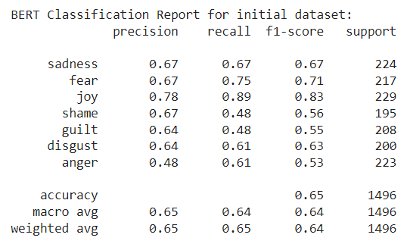
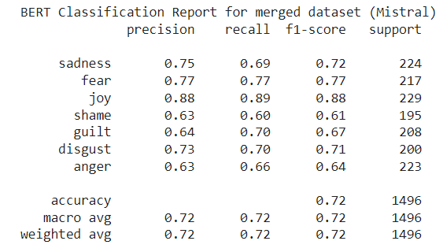
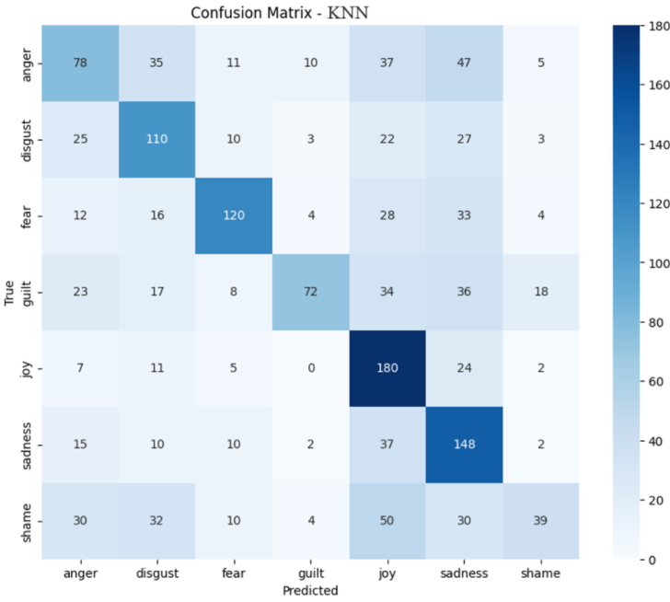
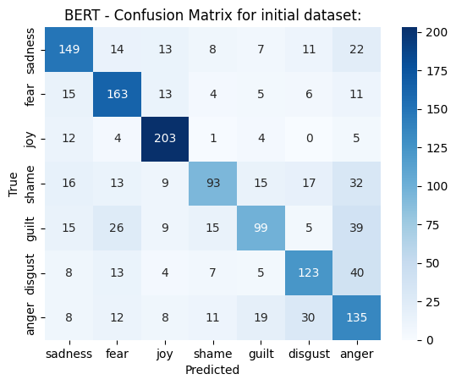
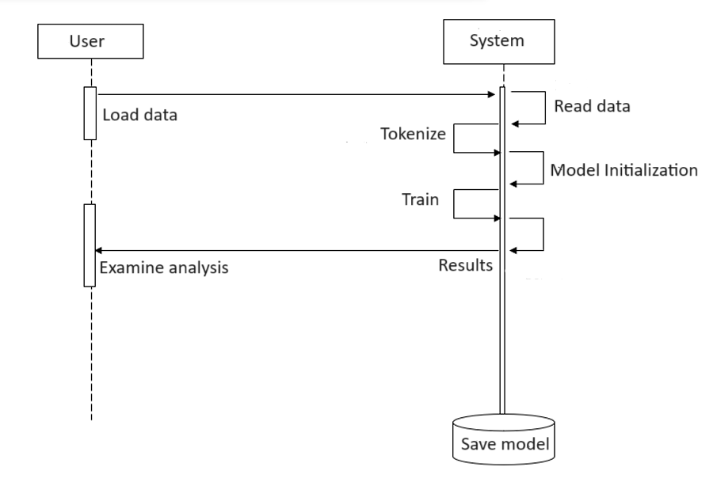
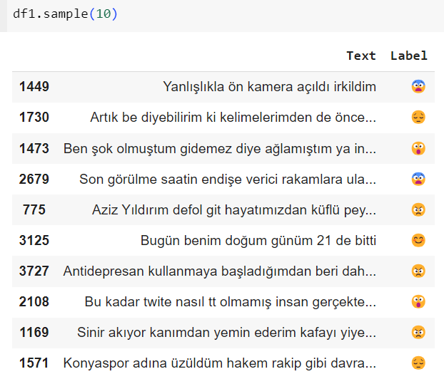
EMOJI PREDICTION AND MODEL ANALYSIS WITH NATURAL LANGUAGE PROCESSING
YILDIZ TECHNICAL UNIVERSITY
FACULTY OF ELECTRICAL AND ELECTRONICS
DEPARTMENT OF COMPUTER ENGINEERING
Bedrettin Şamil Öztürk, Prof. Dr. Mehmet Fatih Amasyalı
samil.ozturk@std.yildiz.edu.tr, amasyali@yildiz.edu.tr
Özet
Dijitalleşen çağımızda yazılı iletişimlerde duyguları doğru iletmek zor hale gelmiştir. Dolayısıyla birçok alanda metinlerdeki duyguların anlaşılması önemlidir. Bu proje, Doğal Dil İşleme ve makine öğrenimi algoritmalarıyla duygu tahmini başarısını artırmayı ve artıran faktörleri incelemeyi amaçlamaktadır. BERT, Bi-LSTM, KNN ve Multinomial Naive Bayes gibi modeller ile TF-IDF ve CountVectorizer gibi vektörizasyon teknikleri kullanılarak çeşitli kıyaslamalı analizler yapılmıştır. Veri artırma yöntemleri uygulanmış ve Hugging Face ile OpenAI arayüzleri kullanılarak Mistral ve gpt-3.5-turbo modelleriyle veri seti zenginleştirilmiştir. Bu yöntemlerin etkisi değerlendirilmiş ve başarı oranlarının arttığı görülmüştür. Kontrol grupları oluşturularak çeşitli başarı ölçütleriyle yapılan karşılaştırmalar, hangi durumlarda modellerin ve veri kümelerinin daha iyi sonuçlar verdiğini göstermiştir. Bulgular, duygu analizi araştırmalarına [1] katkıda bulunarak gelecekteki çalışmalar için değerli bilgiler sağlar.
III. Experimental Results
Performance results using various models and comparing factors were obtained and examined. The impact of generating data using models such as Mistral and GPT-3.5-turbo has been significant and has shown notable improvements in predictive capabilities. Comparative analysis using the BERTurk model revealed that accuracy and F1 scores increased when augmented data was included. Additionally, the impact of increasing emotion labels from five to seven was evaluated and showed that performance varied across different models.
Additionally, the study compared the effectiveness of KNN with TF-IDF and CountVectorizer, demonstrating the superiority of TF-IDF. While Bi-LSTM gave a decent result, giving strong results in the 'Joy' and 'Sadness' categories, it struggled in the 'Anger' and 'Shame' categories. Multinomial Naive Bayes achieved high accuracy despite confusion between 'Disgust' and 'Anger'. KNN performed well in the 'Joy' category but had high misclassification rates in the 'Fear' and 'Guilt' categories. BERTurk outperformed all other models, achieving approximately 72% accuracy, thanks to its contextual understanding, extensive pre-training on the Turkish corpus, and transformer architecture.
The measured effects of data production within the framework of success metrics are shown in the form of classification reports in Figure 3 and Figure 4 below.
Abstract
In our digitalised age, it has become difficult to convey emotions correctly in written communication. Therefore, it is important to understand the emotions in texts in many fields. This project aims to improve the success of sentiment prediction with Natural Language Processing and machine learning algorithms and to investigate the factors that increase the success. Various comparative analyses have been performed using models such as BERT, Bi-LSTM, KNN and Multinomial Naive Bayes and vectorisation techniques such as TF-IDF and CountVectorizer. Data augmentation methods were applied and the dataset was enriched with Mistral and gpt-3.5-turbo models using Hugging Face and OpenAI interfaces. The effect of these methods was evaluated and it was observed that the success rates increased. Comparisons with control groups and various success criteria showed in which cases the models and datasets gave better results. The findings contribute to sentiment analysis researchs [1] and provide valuable information for future studies.
I. Introduction
People often use nonverbal signals to convey their emotions, and these are missing in text communication. Emojis have become indispensable for expressing emotions in written communication. This project aims to improve the understanding and prediction of emotions in texts using Natural Language Processing (NLP) techniques and machine learning algorithms. Existing studies are generally in English and categorize emotions as positive, negative, or neutral, but emotions are more complex than that. This study aims to improve emotion prediction and classification in text by using models such as BERT, BiLSTM, KNN and Multinomial Naive Bayes, as well as vectorization techniques such as TF-IDF and CountVectorizer. The project also includes advanced models and data augmentation methods and also compares performance impacts.
Figure 3 Classification Report for Initial Dataset
Figure 4 Classification Report for Merged Dataset
Confusion matrices comparing the predictions of different models are given in Figure 5 and Figure 6.
II. System Design
System design details the planning of the entire system, from data collection to generating analysis results. The process begins with preparing the selected dataset with appropriate methods for machine learning. Then, a control group is selected for the factors to be compared and model selection is made. KNN, Multinomial Naive Bayes and Bi-LSTM models were run and the results were examined. Comparison of vectorization methods such as TF-IDF and CountVectorizer also takes place at this stage. After these comparisons, text generation is performed with advanced models via APIs to determine the effect of data generation, and the success results are analyzed through the fine-tuned BERT model in the Turkish dataset. By fine-tuning BERT our model achieves enhanced performance in sentiment prediction tasks, demonstrating significant improvements over traditional methods [2]. These analyzes are performed through accuracy, f1-score, recall and precision metrics and are visualized through confusion matrices, allowing clearer observations. The data flow during the system design process is as shown in Figure 1 below.
Figure 5 Classification Report for Initial Dataset
Figure 6 Classification Report for Merged Dataset
Significance of the Findings: Research shows that advanced NLP models and data augmentation techniques make a significant impact in accurately predicting emotions in texts.
Practical Applications: The findings enable customer service chatbots, mental health monitoring systems [3], and social media analysis tools to more accurately detect emotional tones, leading to practical applications in these areas.
Limitations: Limitations of our research include the variability of emotional expressions across different contexts and difficulties in accurately predicting rare emotions. These factors may affect the generalizability of our findings.
Figure 1 Data Flow Diagram
Conclusion
In conclusion, this study explored various methods for emotion prediction in text, including BERTurk, Bi-LSTM, KNN, and Multinomial Naive Bayes, using techniques like TF-IDF and CountVectorizer. Data augmentation and the use of advanced models such as Mistral and GPT-3.5-turbo significantly improved prediction accuracy. Among the methods, BERTurk demonstrated the highest success, achieving superior precision, recall, and F1-scores. Future research could focus on integrating multimodal data and developing models that generalize better across diverse datasets. These findings contribute to the advancement of sentiment analysis, offering practical applications in fields like customer service and mental health monitoring.
Data samples prepared within the scope of data set design and the corresponding emoji labels are shown in Figure 2.
References
[1] Tan, K. L., Lee, C. P., & Lim, K. M. (2023). A Survey of Sentiment Analysis: Approaches, Datasets, and Future Research. Applied Sciences, 13(7), 4550.
[2] Prottasha, N. J., As Sami, A., Kowsher, M., Murad, S. A., Bairagi, A. K., & Masud, M. (2022). Transfer Learning for Sentiment Analysis Using BERT Based Supervised Fine-Tuning. Sensors, 22(11), 4157.
[3] V. Mody and V. Mody, "Mental Health Monitoring System using Artificial Intelligence: A Review," 2019 IEEE 5th International Conference for Convergence in Technology (I2CT)
Figure 2 Dataset Sample
Figure/Şekil 5. Şekil başlığı.

